Slide 1



Technical Analysis Report
Elisabeth Loiselle

Slide 2
50/200 Rule
Tells an investor if they should buy a stock
  Want to buy if 50-day and 200-day moving average trends cross
Does not tell an investor when to sell
MY RULE: Wait 10 days

Slide 3
RSI: Relative Strength Index
Measures the speed and magnitude of an asset’s recent price changes
  Want to identify potential overbought and oversold assets
Overbought is > 70 (green)
  Want to short the stock
Oversold is < 30
  Want to long the stock
MY RULE: Hold for 10 days

Slide 4
Value Stock: Ternium SA (TX)
Subsidiary of The Techint Group
Manufacturer and distributor of steel products
Carries out the marketing and sales of mining products such as pellets and iron ore
Serves construction, automotive, home appliances, agroindustry, packaging, transport, and energy industries
Founded in 2005 in Buenos Aires, Argentina
Headquartered in Luxembourg

Slide 5
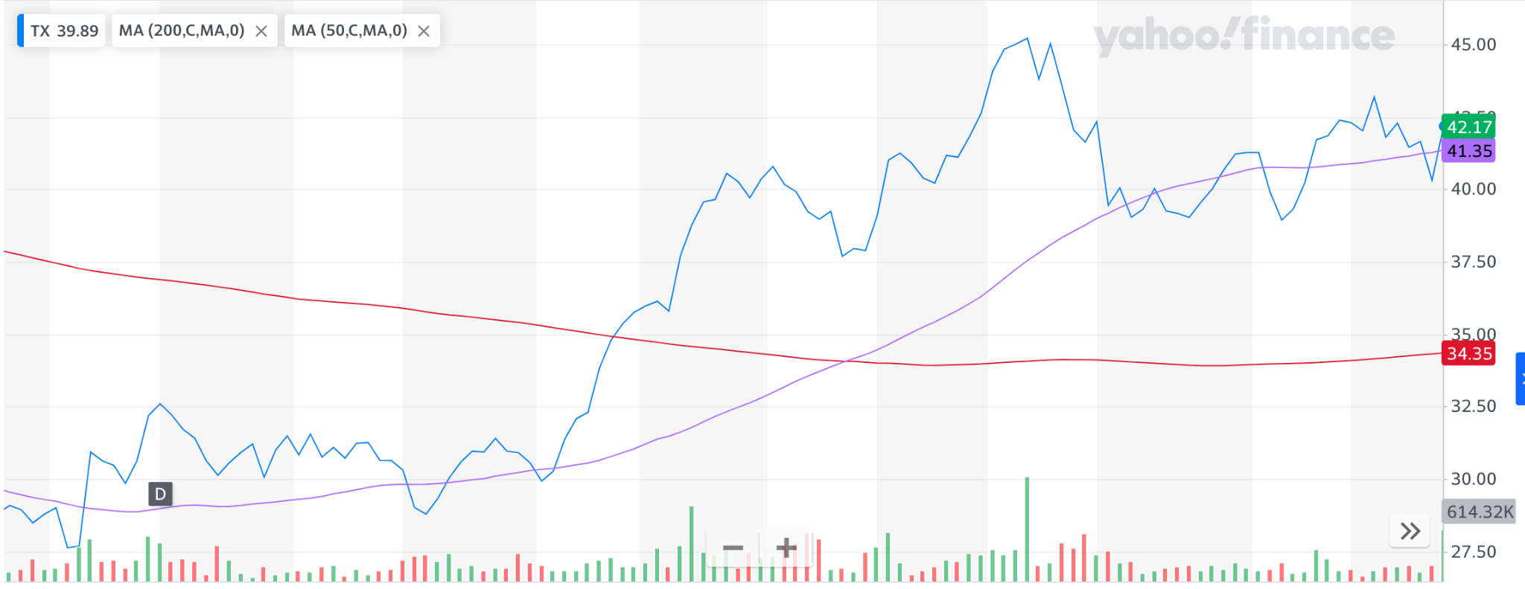
50/200 Rule
WINNER
  2/9/23: BUY at $37.68
    2/22/23: $40.87 ($3.19 profit)

Slide 6
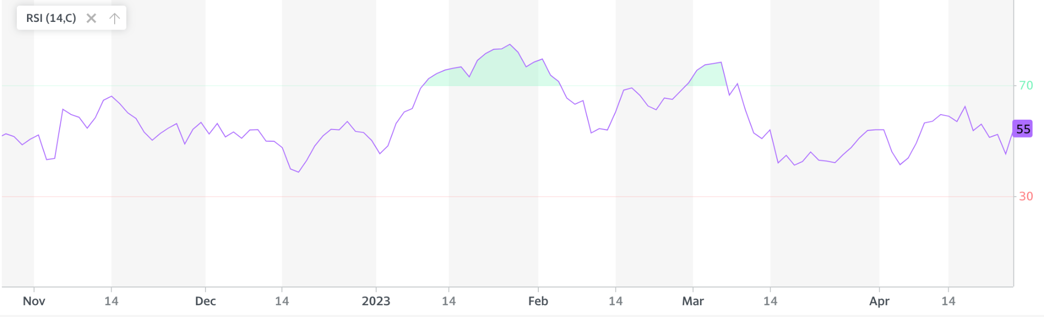
RSI (TX)
OVERBOUGHT (>70) | OVERSOLD (<30)
2 Trades (1/10/23-2/3/23 & 2/28/23-3/7/23) | 0 Trades
WINNER

Slide 7
RSI Analysis
MY RULE: leave the market 10 days after the buy/sell date
Short on 2/3/23: $70
  2/23/23: $65 ➡ $5 profit
Short on 3/7/23: $69
  3/17/23: $52 ➡ $17 profit

Slide 8
Dividend Stock: Dell Technologies Inc. (DELL)
Formerly known as Denali Holding Inc. (changed 2016)
Designs, develops, manufacturer, sells, and supports various comprehensive and integrated solutions, products and services
Operates through Infrastructure Solutions Group (ISG) and Client Solutions Group (CSG)
Also involved in provision of cybersecurity technology-driven security solutions
Founded in 1984 and headquartered in Round Rock, Texas

Slide 9
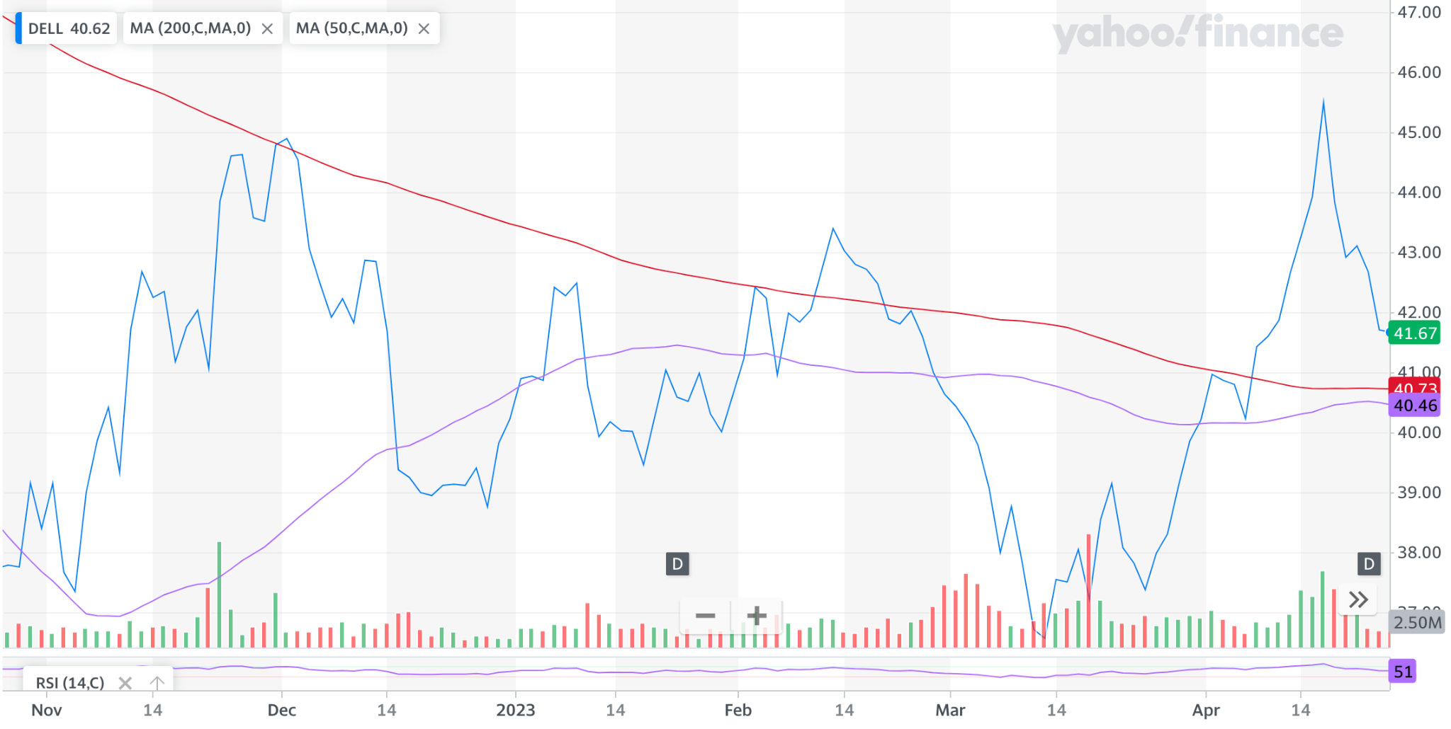
50/200 Rule
NO WIN OR LOSS
  Zero trades because the 50-day and 200-day MA never cross

Slide 10
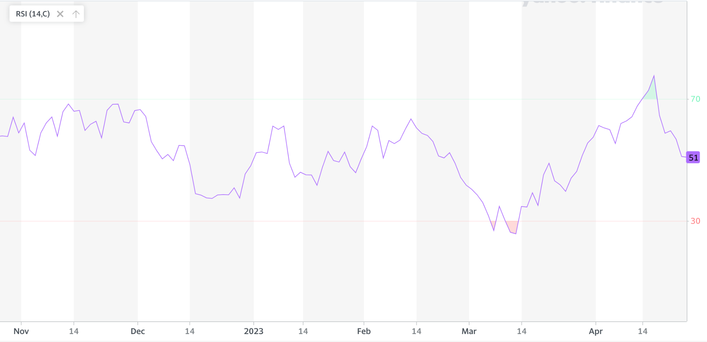
RSI
OVERBOUGHT (>70) | OVERSOLD (<30)
1 Trade (4/16/23-4/19/23) | 2 Trades (3/6/23-3/7/23 & 3/9/23-3/13/23)
WINNER

Slide 11
RSI Analysis
MY RULE: leave the market 10 days after the buy/sell date
Buy on 3/7/23: $30
  3/17/23: $33 ➡ $3 profit
Buy on 3/13/23: $30
  3/30/23: $44 ➡ $14 profit
Short on 4/19/23: $70
  4/28/23: $53 ➡ $17 profit

Slide 12
Junk Bond: Avis Car Rental (CAR)
Engages in the provision of vehicle sharing and rental services
Operates through the Americas and International segments
Founded in 1946 and headquartered in Parsippany, New Jersey

Slide 13
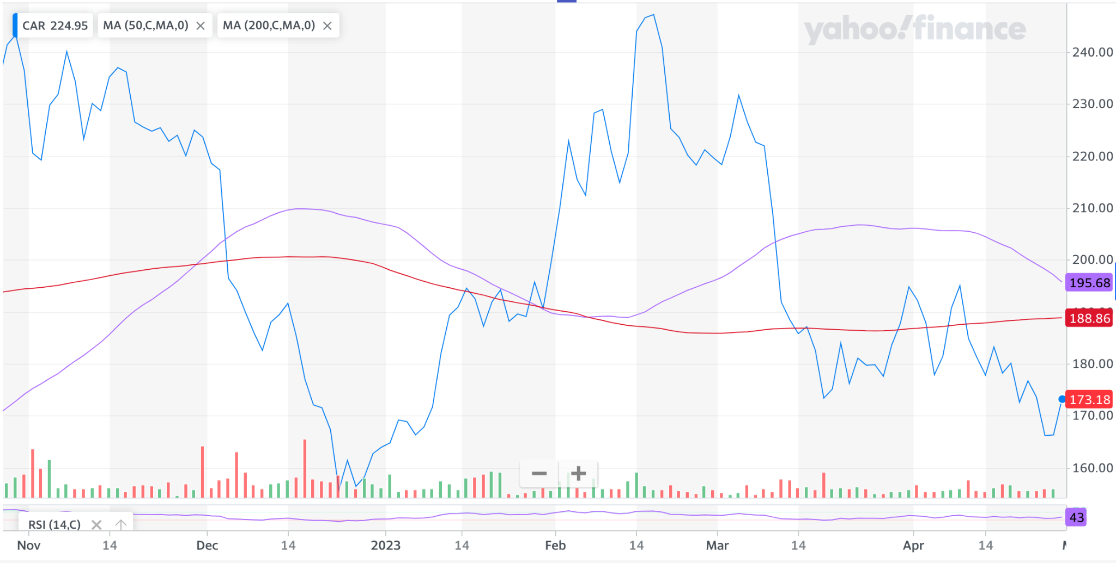
50/200 Rule
WINNER (overall)
  1/30/23 for $190.59 & 2/6/23 for $212.39: Buy at the crosses
    2/9/23: $220.97 ($30.38 profit)
    2/16/23: $247.20 ($34.81 profit)
  11/29/22 for $224.95: $182.54 after 10 days ($42.41 loss)

Slide 14
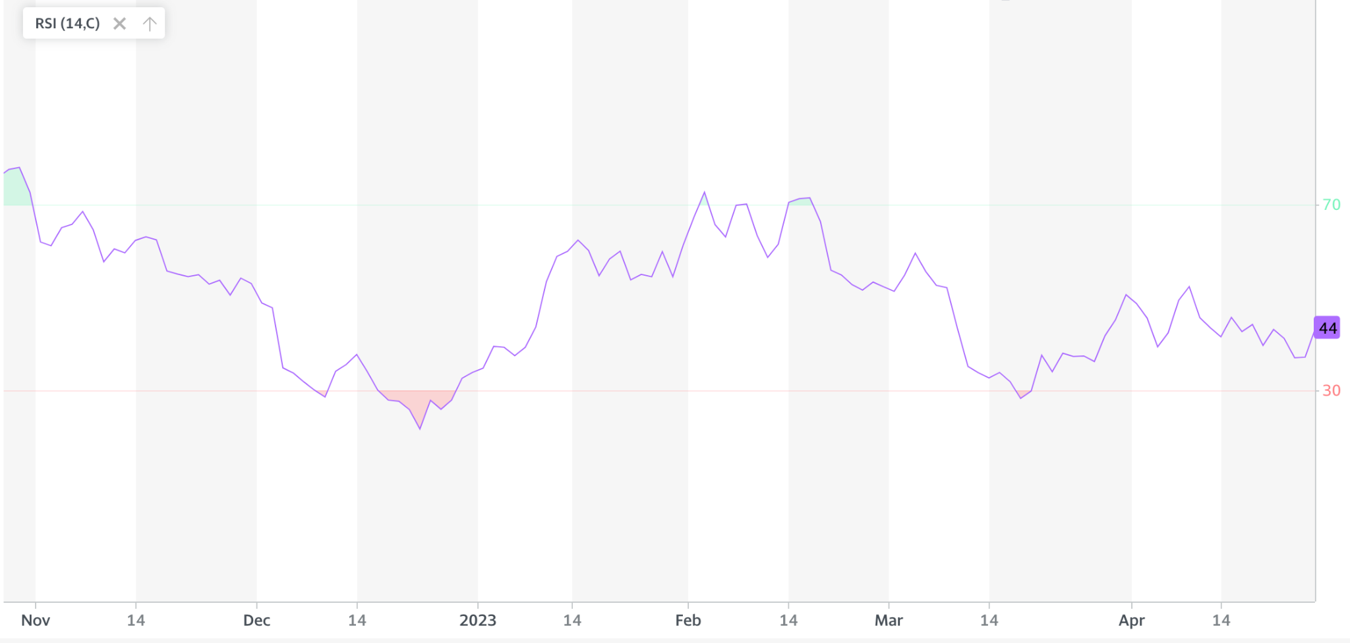
RSI
OVERBOUGHT (>70) | OVERSOLD (<30)
3 Trades (10/24/22-10/31/22 & 2/2/23-2/3/23 & 2/14/23-2/16/23) | 3 Trades (12/8/22-12/9/23 & 12/16/22-12/28/22 & 3/17/23-3/18/23)
WINNER

Slide 15
RSI Analysis
MY RULE: leave the market 10 days after the buy/sell
BUY DATE | STOCK PRICE | SELL DATE | NEW STOCK PRICE | PROFIT/LOSS
10/31/22 | $69 | 11/10/22 | $60 | $9 profit
12/9/22 | $30 | 12/19/22 | $29 | $1 loss
12/28/22 | $30 | 1/6/23 | $39 | $9 profit
2/3/23 | $68 | 2/13/23 | $65 | $3 profit
2/16/23 | $70 | 2/24/23 | $53 | $17 profit
3/18/23 | $30 | 3/30/23 | $41 | $11 profit

