Slide 1
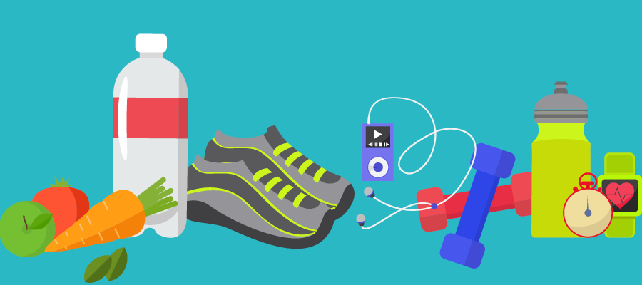
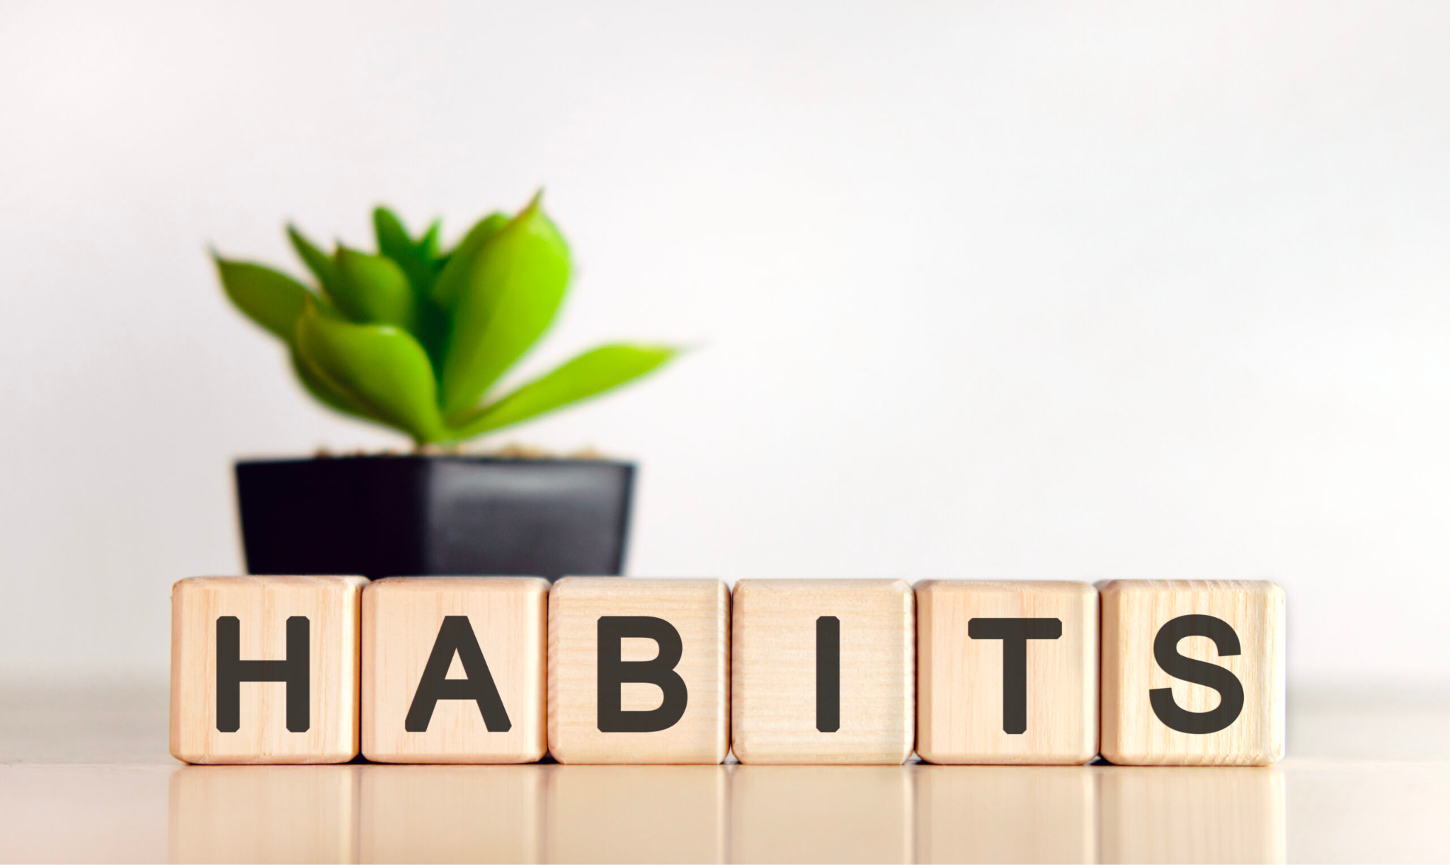
Peak Habits
By Gillian and Elisabeth

Slide 2
To make a positive change, you have to confront your bad habits
Notes:
What does this mean to the class?

Slide 3

Thoughts
Imagine who you want to be and the changes you want to see in yourself
  How will you get there?
  What habits do I need to be successful?
  What habits are more important to you?
  What current habits to change to make new ones?
Notes:
Thoughts to consider throughout presentation

Slide 4
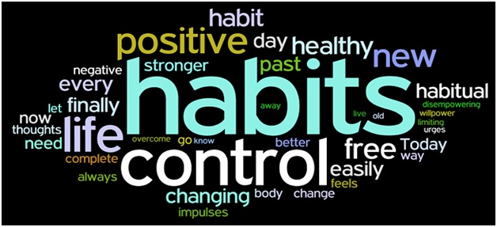
What habits do you have?
Activity:
List 5 positive and 5 negative habits
Rate each on a 1-10 scale (1 being highest, 10 being lowest)
Consider:
Are they actionable or non actionable?
How did you develop these habits?
Are these habits for professional or non professional development?
Notes:
Actionable v non actionable
Rate the habits

Slide 5
What habit do you most want to change?
Notes:
Both talk about a habit we want to change
Gill-
Elisabeth-

Slide 6
Why do you want to change this particular habit?
Is this habit something you want to change? Or do you think this is something you should change?
  What is the difference?
  What can get in the way of building a habit or getting rid of a bad habit?
    Can a habit that was once something you thought should be changed, become something you want to change and continue?

Slide 7
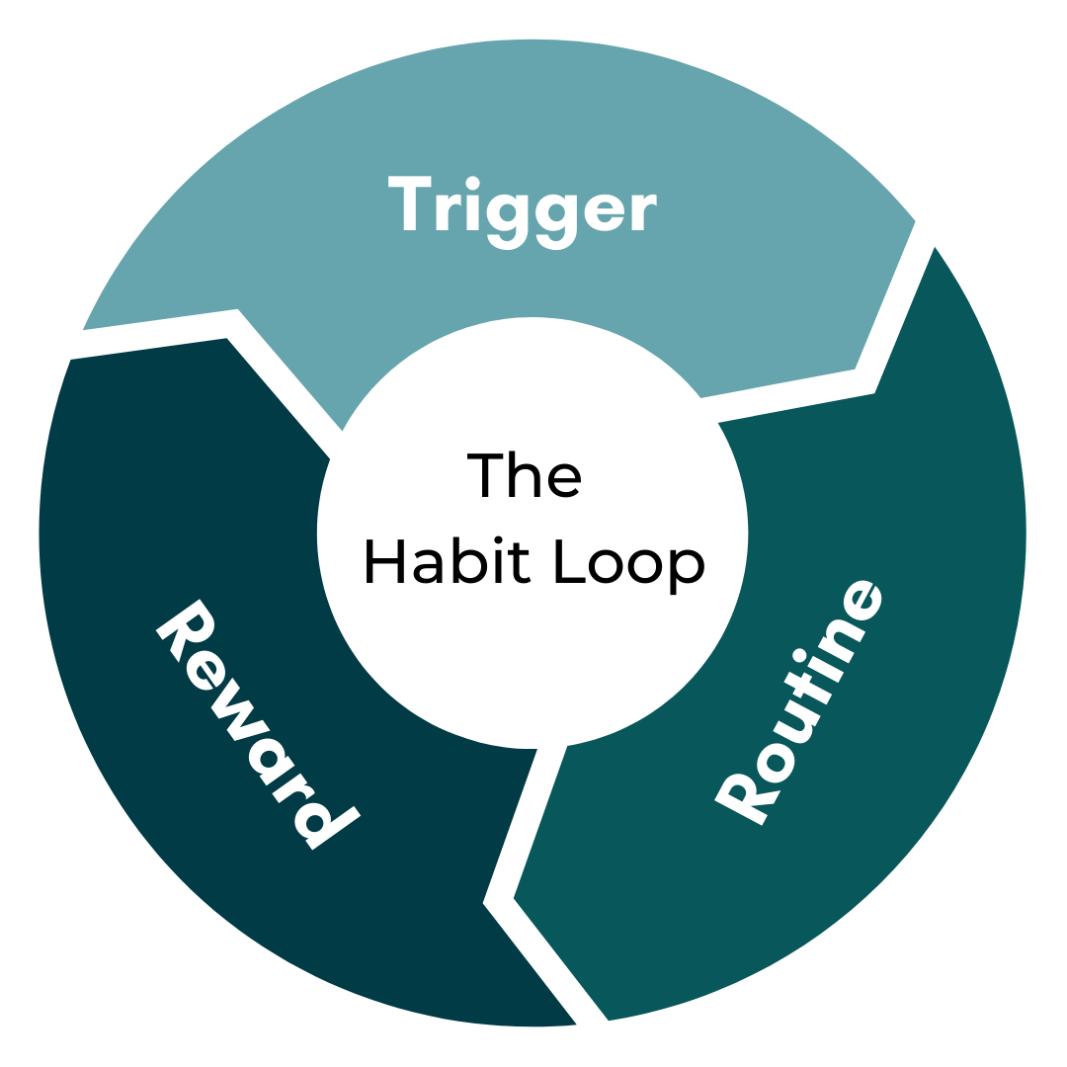
Three Parts of a Habit
Trigger
Routine
Reward

Slide 8
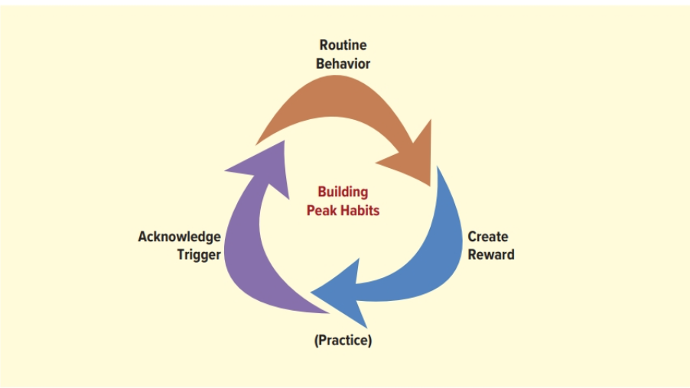
The Habit Cycle

Slide 9
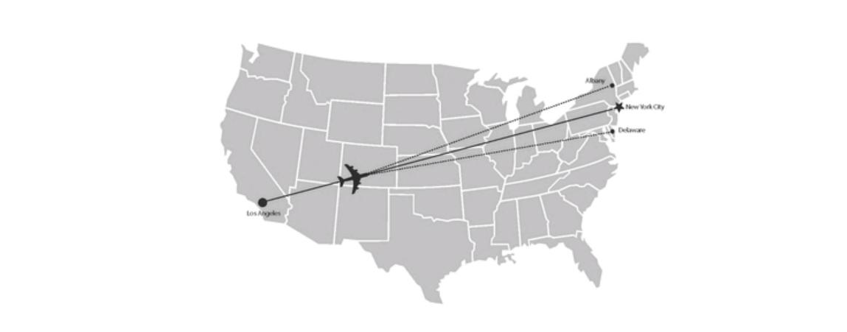
The Compound Effect
“The power of small adjustments: a 1 percent change in course results in being 150 miles off course.” (chapter 3)

Slide 10
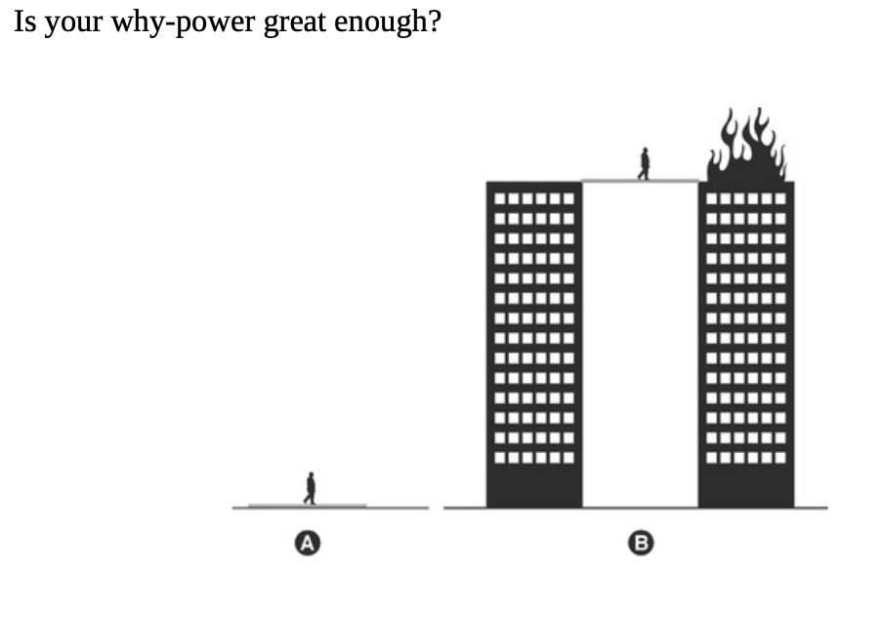
The Compound Effect
Why-power
  “All of the hows will be meaningless until your whys are powerful enough”
Core values
  “Getting your core values defined and properly calibrated is one of the most important steps in redirecting your life toward your grandest vision”
No immediate pay-off
  “Our need for instant gratification can turn us into the most reactive, nonthinking animals around”
Notes:
Elisabeth

Slide 11
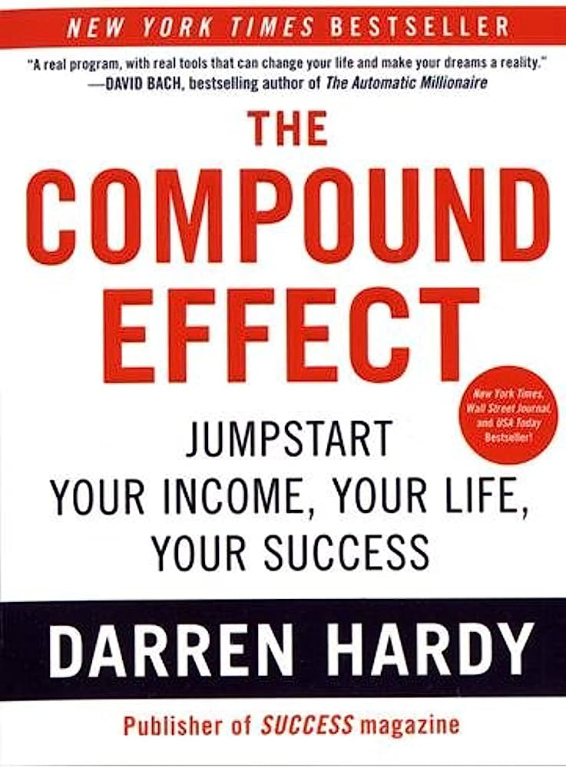
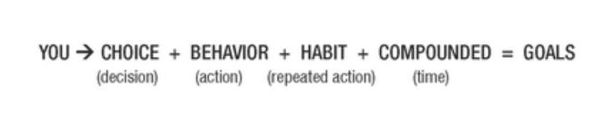
The Compound Effect
Your life comes down to this formula:

Slide 12
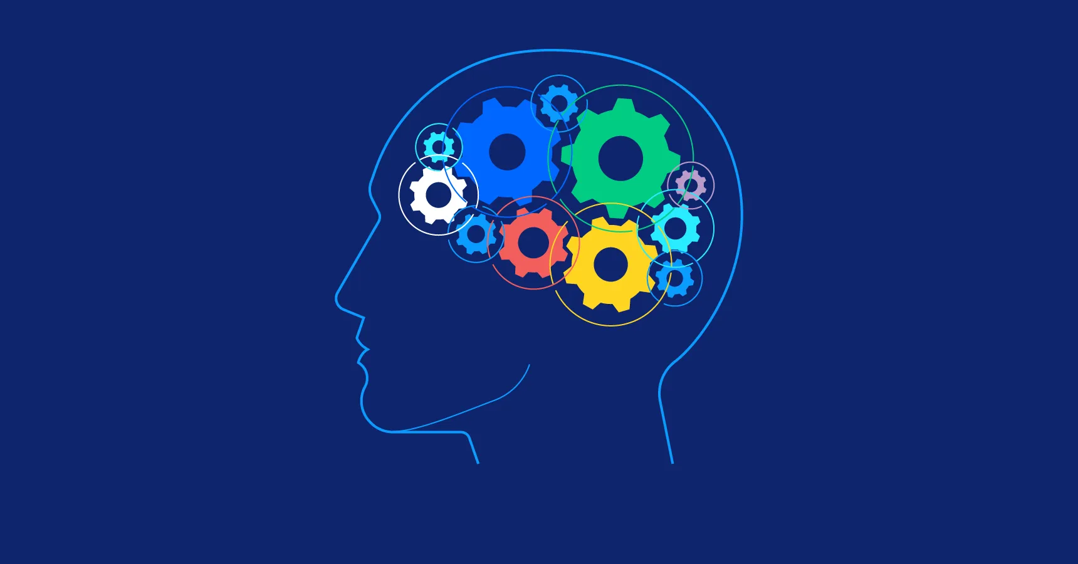
Psychology of Building Habits Reading
During the early stages of habit formation, the decision parts of your brain (prefrontal cortices) are activated, and the action is very deliberate (instead of hitting snooze you make the choice to get out of bed). When a new routine is initiated, brain circuits– also called neural networks– are activated.
The more often you repeat the new action, the stronger and more efficient these neural networks become. This reorganising and strengthening of connections between neurons is called neuroplasticity, and in the case of building habits - long term potentiation. Each time you perform the new action while trying to form a habit, you need smaller cues or triggers to activate the same network of brain cells.
Habits strengthen over time
As habits strengthen, the decision parts of the brain no longer need to kick in to initiate the action.
  The habit is activated in memory and considered automatic
    Neural circuits can perform the habit without conscious thought
Notes:
https://theconversation.com/heres-what-happens-in-your-brain-when-youre-trying-to-make-or-break-a-habit-201189#:~:text=This%20reorganising%20and%20strengthening%20of,same%20network%20of%20brain%20cells.

Slide 13
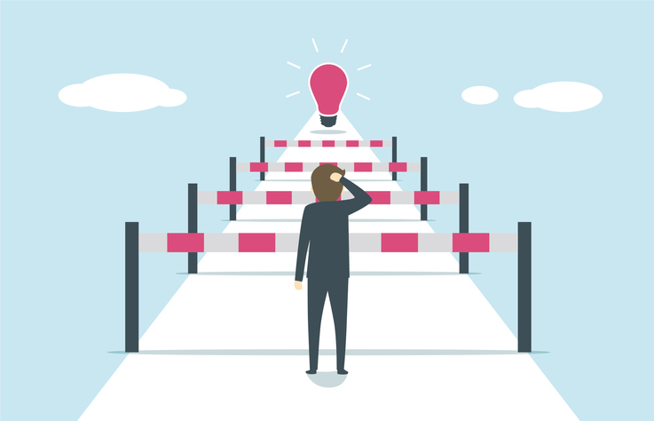
What barriers do you encounter when building habits?
Notes:
Have the class talk about a time they changed a habit
Get stories
What barriers did u encounter
What motivated you
What setbacks did you encounter
Who did u go to for support if anyone
What did u learn about yourself

Slide 14
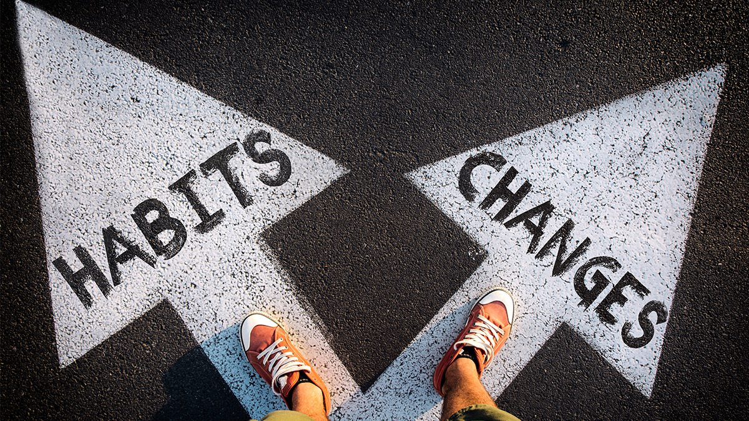
Habits take anywhere between 18 to 254 days to form, with an average of around 66 days.
Notes:
Maybe ask people to tell stories about developing habits?
https://theconversation.com/heres-what-happens-in-your-brain-when-youre-trying-to-make-or-break-a-habit-201189#:~:text=This%20reorganising%20and%20strengthening%20of,same%20network%20of%20brain%20cells.

Slide 15
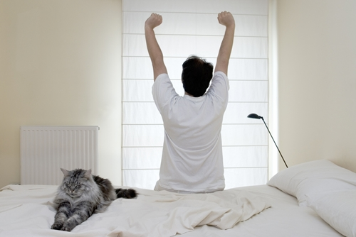

Tips/Strategies
The Power of Two
Write down your goals
Make a daily routine
Track your progress
Create a mantra
Replace your behavior
Find the root cause
Do not act on autopilot
Understand negative triggers
Embrace the unknown
Notes:
https://www.peakperformershuddle.com/blog/when-it-comes-to-building-habits-less-is-more-here-s-why
https://knowablemagazine.org/content/article/mind/2021/the-science-habits
https://www.masterclass.com/articles/how-to-build-a-habit

Slide 16
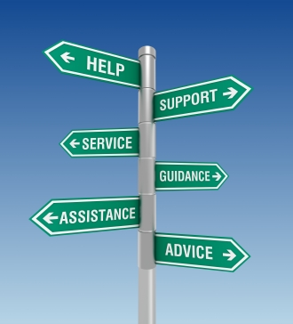
What resources will you use to be successful?

Slide 17

David Goggins
Retired US Navy Seal
Ultramarathon runner, ultra-distance cyclist, triathlete, public speaker, author of two memoirs, and inductee into International Sports Hall of Fame
VFW Americanism award 2018
  Video

Slide 18
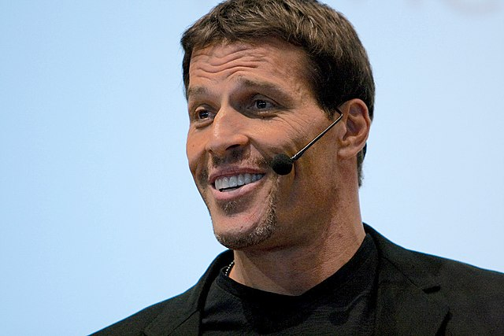
Tony Robbins
Motivational speaker, author, and coach
Known for infomercials, seminars, and self-help books
  Video

Slide 19

Overcoming Obstacles
It’s not easy but can be done
Common obstacles:
  Staying Motivated and consistent with tracking
  Dealing with setbacks and slip-ups
  Adjusting and refining your tracking approach over time

Slide 20
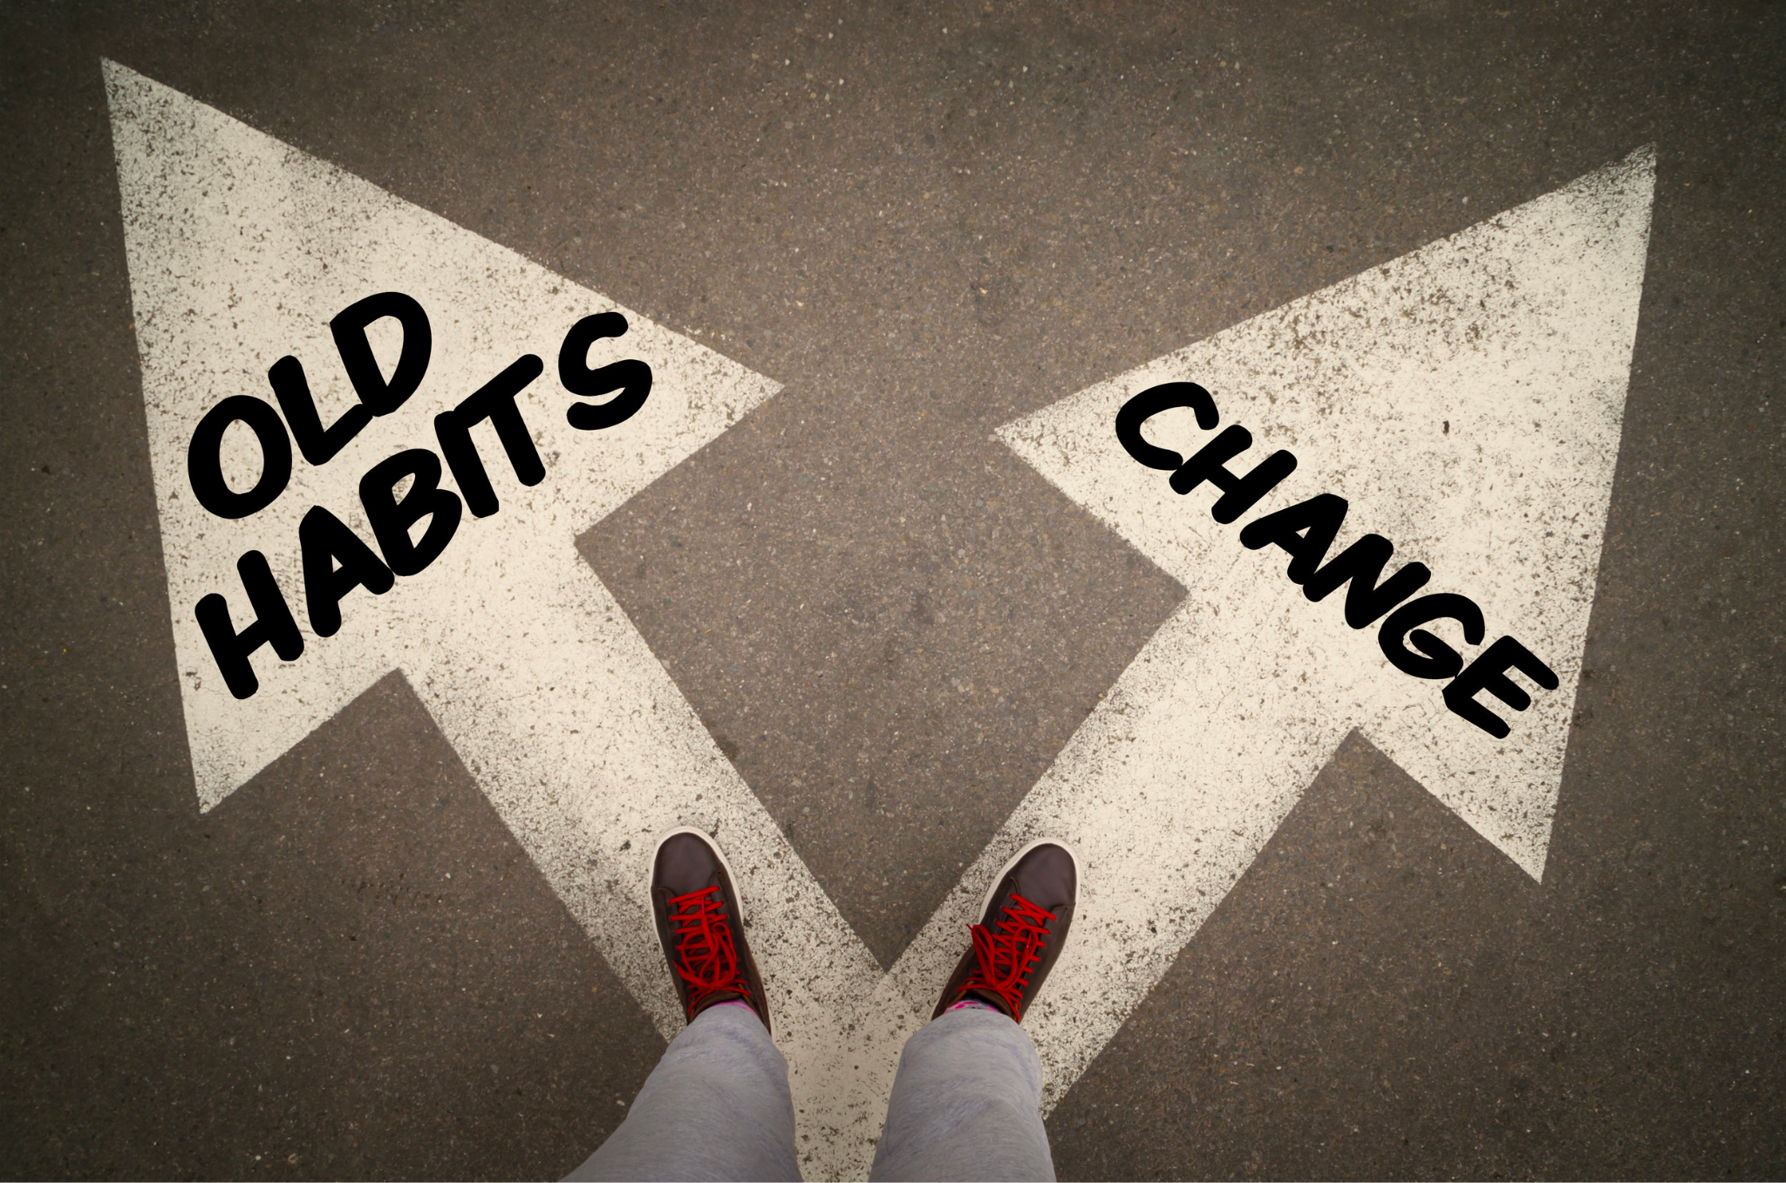
What will use as your trigger?

Slide 21
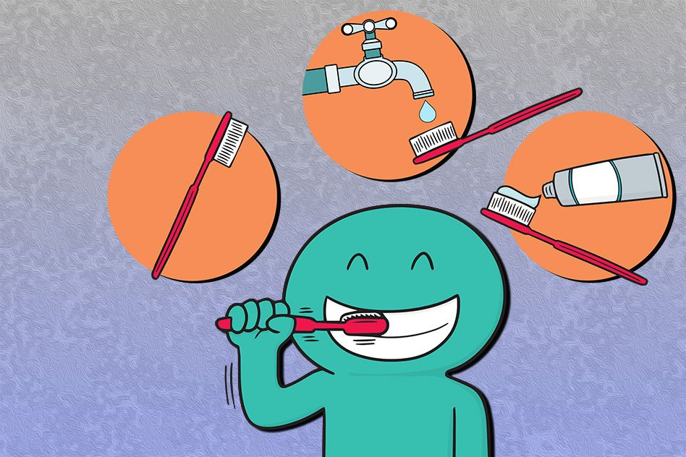
What will be your routine behavior?

Slide 22
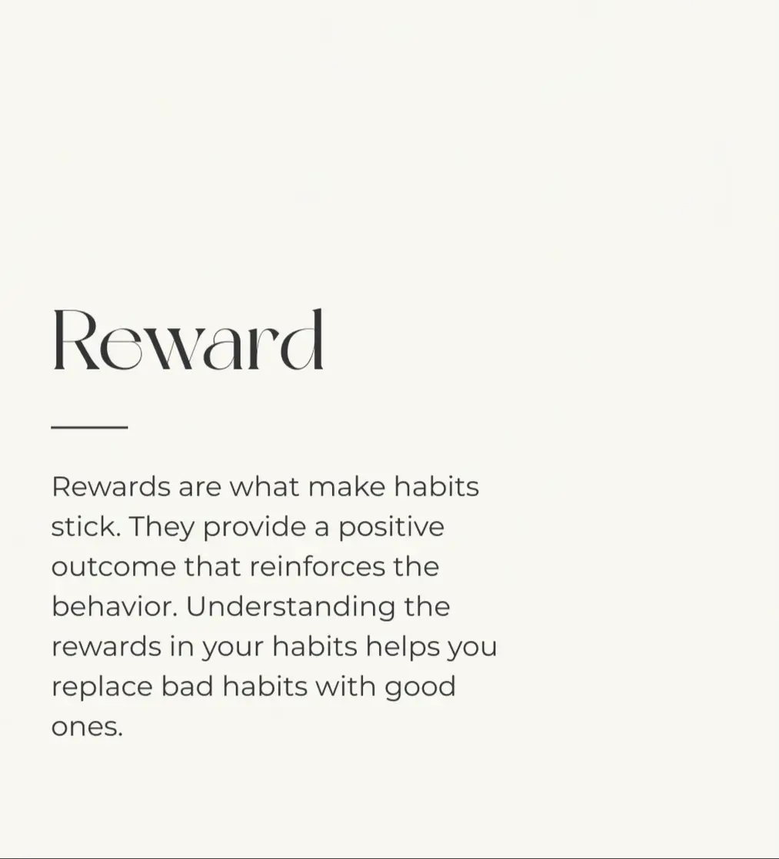
How will you reward yourself?
Notes:
Class discussion on different ways to reward yourself

Slide 23
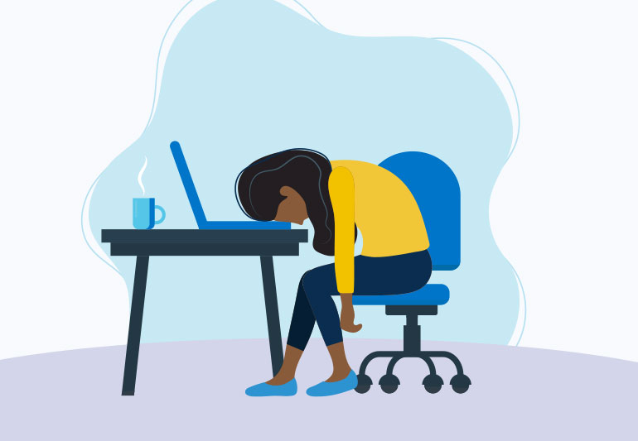
What will the consequences be for not achieving the results you want?

Slide 24
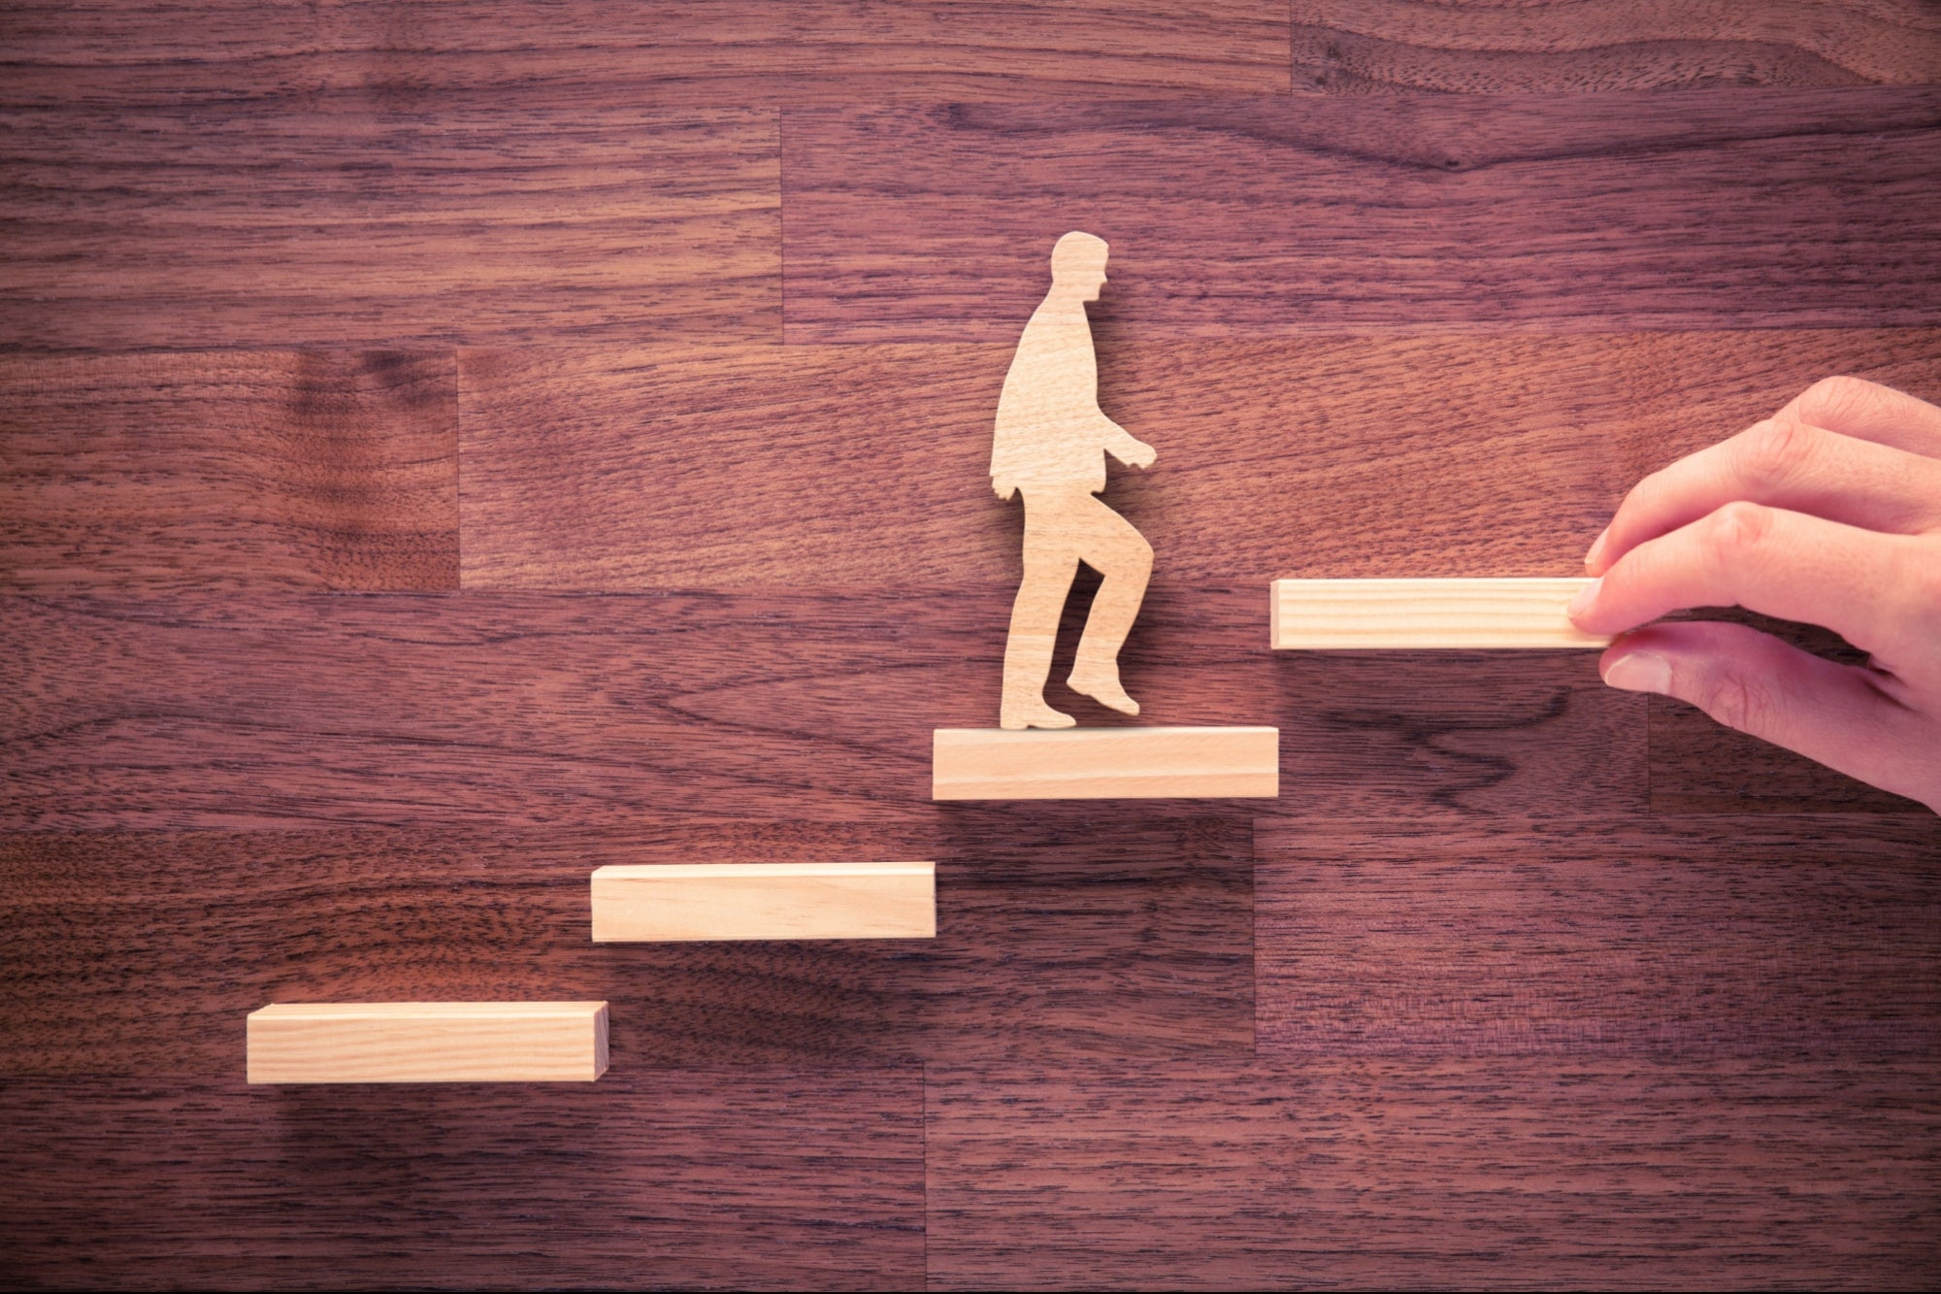
Helping Someone Else Changes Habits
Our coaching sessions
Lead by example
Suggest goals
Give the right feedback
Support good habits
Develop support networks
Notes:
https://greatergood.berkeley.edu/article/item/six_ways_to_help_people_change

Slide 25
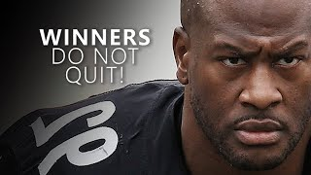
Motivational Takeaway
Notes:
At the end of the day, it comes down to your commitment

Slide 26
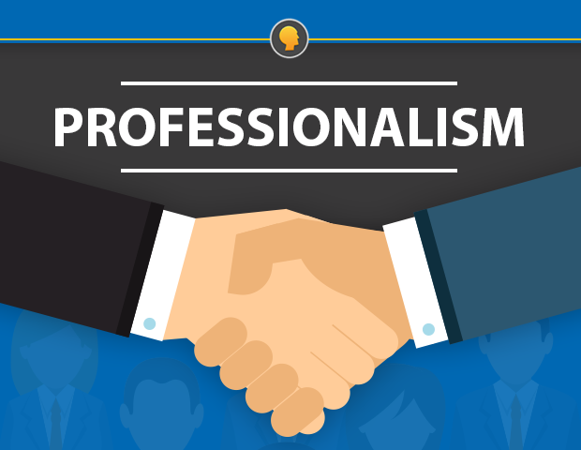
What habits are professional
What habits are essential to the workplace?
What habits are associated with being professional in the workplace
Being on time
Having a voice- and knowing when to use it
Asking for help
Being adaptable
Maintaining a professional attitude
Being helpful
Being a positive presence
Notes:
https://hive.com/blog/good-professional-habits/

Slide 27
Sources
https://theconversation.com/heres-what-happens-in-your-brain-when-youre-trying-to-make-or-break-a-habit-201189#:~:text=This%20reorganising%20and%20strengthening%20of,same%20network%20of%20brain%20cells.
https://theconversation.com/heres-what-happens-in-your-brain-when-youre-trying-to-make-or-break-a-habit-201189#:~:text=This%20reorganising%20and%20strengthening%20of,same%20network%20of%20brain%20cells.
https://www.peakperformershuddle.com/blog/when-it-comes-to-building-habits-less-is-more-here-s-why
https://knowablemagazine.org/content/article/mind/2021/the-science-habits
https://www.masterclass.com/articles/how-to-build-a-habit
https://inlpcenter.org/overcoming-obstacles/
https://greatergood.berkeley.edu/article/item/six_ways_to_help_people_change
https://hive.com/blog/good-professional-habits/
Build Peak Habits: Chapter 2 from Peak Performance: Success in College and Beyond, 12th Edition by Ferrett, 2024
Books, Eureka. The Compound Effect. IDreamBooks Inc, 2015.

